Slide 1
“E-commerce Website”
Task - 3

Slide 2
E-Commerce Websites
E-commerce websites enables business to sell products or services online . Customers browse product listings , add items to a digital shopping cart , and proceed to checkout.
Payment and shipping details are securely processed.
The website streamlines the buying process , making it convenient and accessible and serves as a powerful tool for businesses to reach a global customers base and boost online sales
LMS Username | Name | Batch
au910020104006 | Anu M | CC2
au910020104017 | Kabilan K | CC2
au910020104022 | Krishnan E | CC2

Slide 3
Task 3 :: Frontend Creation
Create various Front End Programs
Draw and design a uniform front end code for “Your Project”
Draw and design a interactive front end code for “Your Project”
Evaluation Metric:
100% Completion of the above tasks
Learning outcome
Developing complicated UI using HTML components
Using props drilling and context to pass variables
Getting familiar with different type of api calls
Handling different input data

Slide 4
Evaluation Metric:
1. User Interface (UI) Design:- Evaluate the overall design aesthetics, clarity, and consistency of the user interface.
2. Responsive Design:- Ensure that the website provides a seamless and visually appealing experience across various devices and screen sizes.
3. Page Load Speed:- Measure the time it takes for web pages to load to ensure a fast and responsive user experience.
4. Navigation and Site Structure:- Assess the ease of navigation and the logical organization of content throughout the website.
5. Search Functionality:- Evaluate the effectiveness and efficiency of the search feature in helping users find products.
6. Product Presentation:- Review how products are displayed, including images, descriptions, and pricing, to enhance the user's understanding.

Slide 5
7. Checkout Process:- Analyze the simplicity and user-friendliness of the checkout process to minimize abandonment rates.
8. Forms and Data Input:- Check the usability of forms for account creation, login, and data input, ensuring a smooth process for users.
9. Interactive Elements:- Assess the functionality and responsiveness of interactive elements such as buttons, sliders, and product filters.
10. Performance Across Browsers:- Verify that the website functions well across different web browsers to ensure a consistent user experience.
11. Accessibility:- Evaluate the website's accessibility features to ensure it complies with standards, making it usable for individuals with disabilities.
12. Error Handling and Messaging:- Check how the website handles errors, displays error messages, and guides users through problem-solving scenarios.

Slide 6

Step-Wise Description
1.Define Requirements:- Identify and document the requirements for your E-Commerce website, considering the type of products, target audience, and desired features.
2.Market Research:- Conduct market research to understand industry trends, competitor websites, and user expectations. This will help you design a competitive and user-friendly interface.
3.Wireframing:- Create wireframes to outline the layout and structure of key pages, such as the homepage, product pages, and checkout process. This provides a visual guide before diving into detailed design.
4.Design Mockups:- Develop detailed design mockups based on the wireframes. This includes finalizing color schemes, typography, imagery, and other visual elements.
5.Choose Frontend Technologies:- Select the appropriate frontend technologies based on your project requirements. Common technologies include HTML, CSS, and JavaScript frameworks such as React, Angular, or Vue.js.
6. Set Up Version Control:- Implement version control (e.g., Git) to track changes, collaborate with team members, and easily revert to previous versions if needed.
7.Create HTML/CSS Templates:- Develop HTML and CSS templates based on the approved design mockups. Ensure the templates are responsive and compatible with various devices.

Slide 7
8.Implement Interactivity with JavaScript:- Use JavaScript to add interactive elements such as sliders, dropdowns, and modals. If using a frontend framework, integrate it into the project.
9.Integrate with Backend:- Connect the frontend with the backend system to fetch and display product information, handle user authentication, and manage transactions.
10.Implement E-Commerce Functionality:- Add essential E-Commerce features, including product listing, search functionality, shopping cart, and a seamless checkout process.
11.Optimize Performance:- Optimize the frontend performance by minimizing file sizes, leveraging browser caching, and using content delivery networks (CDNs) to ensure fast page loading times.
12.Testing:- Conduct thorough testing of the frontend, including cross-browser testing, responsiveness testing, and functional testing to identify and fix any issues.
13.User Feedback and Iteration:- Gather feedback from potential users, stakeholders, and team members. Use this feedback to make necessary improvements and iterate on the design and functionality.
14. Launch:- Once testing and iterations are complete, launch the frontend to the production environment. Monitor for any issues and be prepared to address them promptly.
15. Monitor and Maintain:- Continuously monitor the performance of the frontend, address any user feedback, and make updates as needed.

Slide 8
Summary of your Task
Creating the frontend for an E-Commerce website is a meticulous process involving several key steps. It begins with defining the project requirements and conducting market research to understand industry trends and user expectations. The next steps include wireframing and designing mockups to visually outline the website's structure and aesthetics. Frontend technologies, such as HTML, CSS, and JavaScript frameworks, are chosen based on project needs. The development process involves setting up version control, creating responsive HTML/CSS templates, implementing interactivity with JavaScript, and integrating the frontend with the backend system. E-Commerce functionality, including product listing, search, shopping cart, and checkout processes, is added. Optimization for performance is a critical step, ensuring fast page loading times through techniques like file size reduction and content delivery networks. Thorough testing, including cross-browser and responsiveness testing, precedes user feedback collection and iterative improvements. The final steps involve launching the frontend, monitoring its performance, and maintaining regular updates to stay current with design trends and security requirements. This comprehensive approach ensures the creation of a well-designed, functional frontend that delivers a positive and seamless user experience for an E-Commerce website.

Slide 9
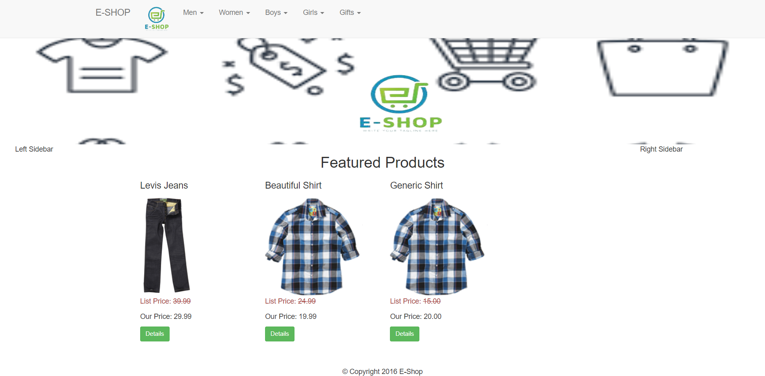
Front-End User Interface

Slide 10
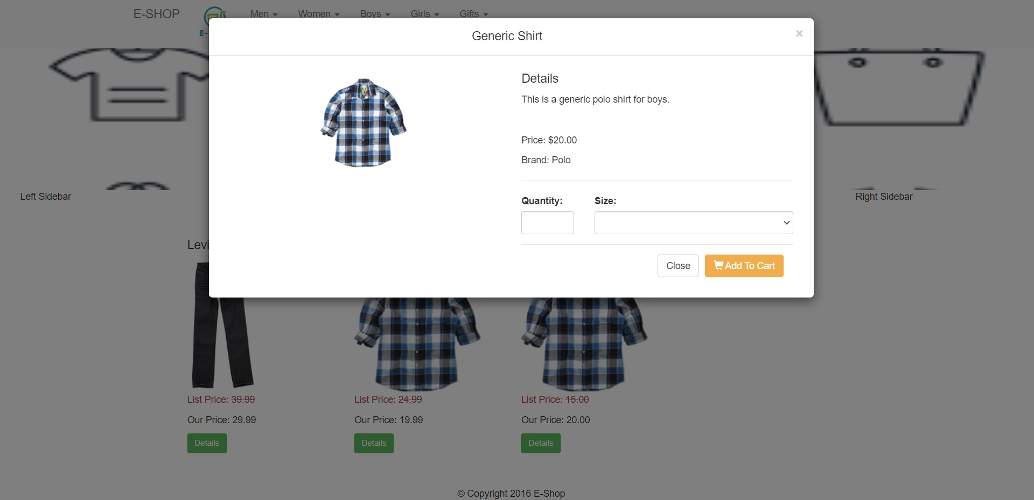

Slide 11
Assessment Parameter
Create folder structure for HTML application
Render Conditional components
Write Functions for event handling
Check-List
Overall UI of the project
Use props to pass variables
Handling broken links
Use ApI calls for data
Optimizing render cycle

Slide 12
Submission Github
https://github.com/Anuledger2003/E-COMMERCE_WEBSITE

